Slide 1
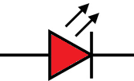
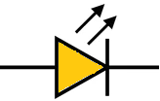
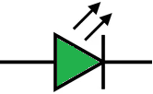

FPGA Block Diagram 1 / 3
FPGA block diagram : both PS and PL side
PS side
Zynq XC7Z020
QSPI
Serial Flash
S25FL128
(16MB)
Ethernet PHY
(RTL8211)
GMII
LAN
(10/100)
MDIO
LAN link service
(10/100)
Protocol comm.
- TCP service (port 23)
- CMD Rx service
- EVT Tx service
Maintenance comm.
- TCP(7023) & UART
- monitoring service
- user CMD service
UART
PS_CLK
ARM PLL
1000M
Laser control
- Laser on/off control
- Laser temp. control
Miscellaneous feature
- Watchdog service
- fake PHD data gen.
- LED control
LED2 : MCU run (1 Hz)
50MHz
DDR PLL
1000M
LED3 : reserved
IO PLL
800M
1
LED4 : FPGA run (1 Hz)
PL side
LED & TP
control block
LED5 : reserved
50MHz
CLK125M
Control REG
block
Test Pin (TP8~TP11)
CLKP/N
EEPROM control
block (SPI)
EEPROM
ADC3660
FCLK1(160M)
SEN
SCLK
SDIO
DCLK
FCLK
DA5/6
DB5/6
CLKP
CLKN
RESET
PDN
DCLKIN
ADC control block (SPI)
fake ADC
data gen. block
DMA + control block
(raw ADC write)
temp. PID
control block
DAC
5MHz
DDR3
MT41K256M16
(16-bit, 256M)
x64
ch A
ADC data
single capture
40MHz
ADC data
Rx block
5MHz
ADC data
mixing & gain correction
block
fake PHD
data gen.
block
DPRAM +
particle counting
block
(512 ch)
color notification
x64
x64
x1
x1
HW component
Analog
PD
signal
ch B
Peak
detect
block
vtg to ch determine
block
FPGA F/W design finished
10MHz
ADC clock
control
block
FPGA circuit design finished
GCF calc.
block
TCF calc.
block
FPGA circuit to be designed
40MHz
vtg to ch mapping table
(log scale, 512ch)
XADC (12-bit)
Vp/Vn Vad0~3
temperature sensor (4ea)
- laser temperature
- env. temperature
LPF
reference
voltage

Slide 2
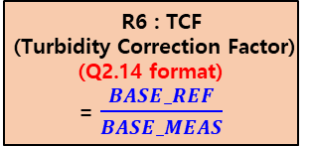
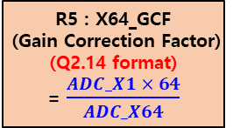
FPGA Block Diagram 2 / 3
FPGA block diagram : ADC data manipulation detail
RXD_A[15:0]
RXD_B[15:0]
output : offset binary
Select : 12.5 mV boundary
ADC_x1 ≥ 0x100 : Z = RXD_B
ADC_X1 < 0x100 : Z = RXD_A
MULT
ADC
3660
ADC_
RXD
Baseline
Wander
Tracking
&
Corrector
DC
Offset
Correct
Neg.
cancel
&
Pos.
range
shift
RXD_B
x1
Ch B
A
MULT
Z
64
MUX
ADC_RXD[31:0]
ADC_DONE
MULT
Analog
PD signal
x64
Ch A
RXD_A
B
EN
EN
MUX
GCF_EN
MUX
TCF_EN
R5 : X64_GCF
(Gain Correction Factor)
(Q2.14 format)
= $\frac{ADC_X1 × 64}{ADC_X64}$
0x4000
= 1.0000(Q2.14)
0x4000
= 1.0000(Q2.14)
ADC_MIXER
R0 : CTRL_REG
PS : BASE_REF
- 750 mV (0xC000)
R1 : NOISE_TH
R6 : TCF
(Turbidity Correction Factor)
(Q2.14 format)
= $\frac{BASE_REF}{BASE_MEAS}$
R2 : PLS_WIDTH_MIN
LPF
XADC
(FPGA)
PS : BASE_MEAS
R3 : PLS_WIDTH_MAX
PS measure
R4 : PLS_INTV_MIN
Acronyms
- GCF : Gain Correction Factor
- TCF : Turbidity Correction Factor
Constant
value
Register
(PS calculate)
Register
(PS setting)
Note : XADC res = $\frac{1,000 mV}{65536}=0.015258789$

Slide 3
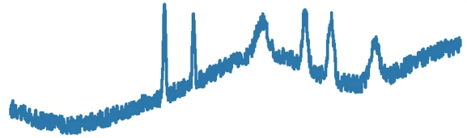
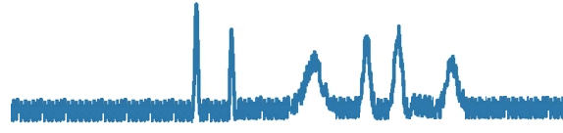
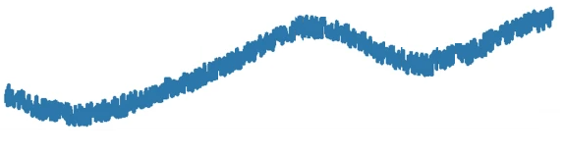

FPGA Block Diagram 3 / 3
Baseline wander tracking & rejection basic idea
- 2 methods considered, choose method 2
- LPF(Low Pass Filter) : implemented using FIR(Finite Impulse Response) Filter
Method 1) using High Pass Filter & Moving Average Filter
Delay
Delay
HPF
(High Pass Filter)
-
+
Moving Average
Filter
+
-
① input signal
③ filtered signal = ① - ②
② Filter output
Method 2) using Low Pass Filter
Delay
LPF
(Low Pass Filter)
-
+
③ filtered signal = ① - ②
① input signal
② Filter output

Slide 4
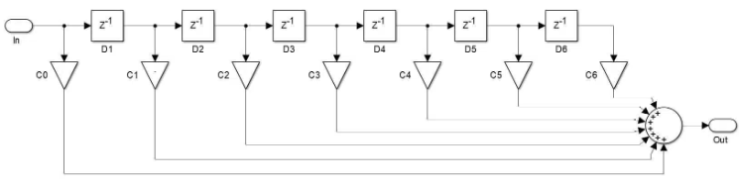
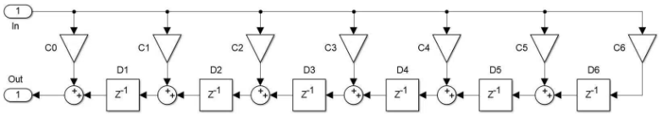
FPGA Block Diagram 4 / 3
Baseline wander tracking & rejection detail
FIR (Finite Impulse Response) Filter : 공식은 아래식과 같으며 구성은 2가지 방법 중 선택하여 구현
Y[n] = C0·X[n] + C1·X[n-1] + C2·X[n-2] + C3·X[n-3] + · · · · · + Cn·X[n-M]
M = number of tap, Cn = filter coefficient, X[n] = input, Y[n] = filtered output
filter tap 및 filter coefficient 는 filter 특성 simulation 하면서 결정 필요.
register(delayed data)
multiplier
adder
- multiplier operates simultaneously
- addition requires stepped delay, because all additions can not be operated at the same time
Direct form FIR filter
Transposed form FIR filter

Slide 5
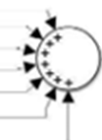
FPGA Block Diagram 5 / 3
Serial-parallel FIR filter
- 필요 resource(multiplier, adder) 사용 최소화 위해, serial 및 parallel 동작 mix 된 형태로 구성
- Filter 특성 :
1) band width 5%, 75dB attenuation (-75dB = 0.00018)
2) FIR Filter Tap = atten / 22 x Fs / (Fstop – Fpass) = 75 / 22 x 100 / 5 = 69 taps
3) Filtered output, Y[n] = C0·X[n] + C1·X[n-1] + C2·X[n-2] + · · · · · + C68·X[n-68] // 69 taps
= YS[fir_0] + YS[fir_1] + YS[fir_2] + · · · · · + YS[fir_13] // 14 parallel FIR x 5 serial FIR
4) serial FIR, YS[n] = C0·X[n] + C1·X[n-1] + C2·X[n-2] + C3·X[n-3] + C4·X[n-4]
X[n]
Serial FIR_0
(for tap : 0~4)
YS[0]
C[68:0]
X[n-4]
Serial FIR_1
(for tap : 5~9)
YS[1]
X[n-9]
Y[n]
Serial FIR_2
(for tap : 10~14)
YS[2]
X[n-14]
X[n-64]
Serial FIR_13
(for tap : 65~69)
YS[13]

Slide 6
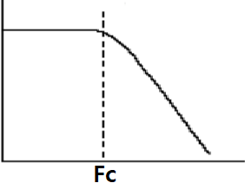
FPGA Block Diagram 6 / 3
FIR filter cascading
- FIR filter 1 단으로 구성시 38,000 개의 tap 이 필요함. (= 38,000 개의 multiplier + adder 필요)
- 69 tap 사용한 FIR filter 3 단 cascading 형태로 구성.
- down sampling 시 alias 문제 해결을 위해 LPF 가 필요함.
LPF
LPF
LPF
down sampling
1/16 = 625KHz
down sampling
1/16 = 39KHz
X[n]
Y[n]
< FIR Filter 1 >
- Fs : 10 MHz
- Fc : 150 KHz
- Fstop : 300 KHz
< FIR Filter 2 >
- Fs : 625 KHz
- Fc : 15 KHz
- Fstop : 30 KHz
< FIR Filter 3 >
- Fs : 39 KHz
- Fc : 2 KHz
- Fstop : 4 KHz

Slide 7
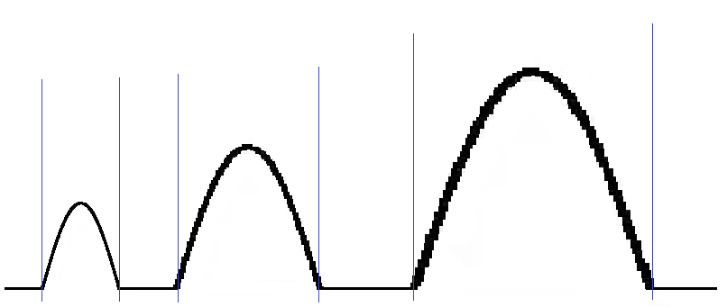
FPGA Block Diagram 7 / 3
Baseline wandering 제거용 Filter 특성 결정을 위한 analog 신호 주파수 성분 추정
- analog 신호 주파수 범위는 10 KHz ~ 50 KHz 정도로 추정
- 여유를 더해 Filter Fc(cutoff 주파수) 는 1 KHz 로 선정
50 usec
(10 KHz)
500 sample
10 usec
(50 KHz)
100 sample
20 usec
(25 KHz)
200 sample
sampling : 10 MHz (100 nsec)

Slide 8
FPGA Block Diagram 8 / 3
FPGA block diagram : ADC data DMA data allocation
DMA_addr + 0
DMA_addr + 1
DMA_addr + 2
DMA_addr + 3
1st ADC data
DMA_addr + 4
DMA_addr + 5
DMA_addr + 6
DMA_addr + 7
DMA_addr + 8
DMA_addr + 9
MSB
LSB
DMA_addr + 10
ADC_X1
ADC_X64
ADC_MIXED
DMA_addr + 11
2nd ADC data
DMA_addr + 12
DMA_addr + 13
DMA_addr + 14
DMA_addr + 15
. . . . .
ADC
signal
Mixer
ADC_X1
(16-bit)
PD raw
ADC signal
DMA_addr + (N-1) x 8 + 0
ADC_MIXED
(32-bit)
DMA_addr + (N-1) x 8 + 1
DMA_addr + (N-1) x 8 + 2
ADC_X64
(16-bit)
DMA_addr + (N-1) x 8 + 3
Nth ADC data
DMA_addr + (N-1) x 8 + 4
DMA_addr + (N-1) x 8 + 5
DMA_addr + (N-1) x 8 + 6
DMA_addr + (N-1) x 8 + 7

Slide 9
FPGA Block Diagram 9 / 3
Analog Circuit DC offset voltage measure
Case 1)
PD
Simulator
base line : 400 mVdc
signal : 0 mV
H-sensor
GND
Case 2)
PD
Simulator
H-sensor
GND

